Slide 1
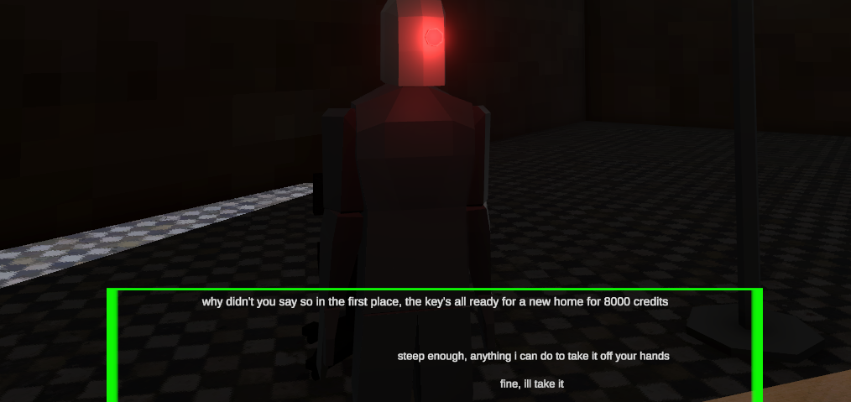
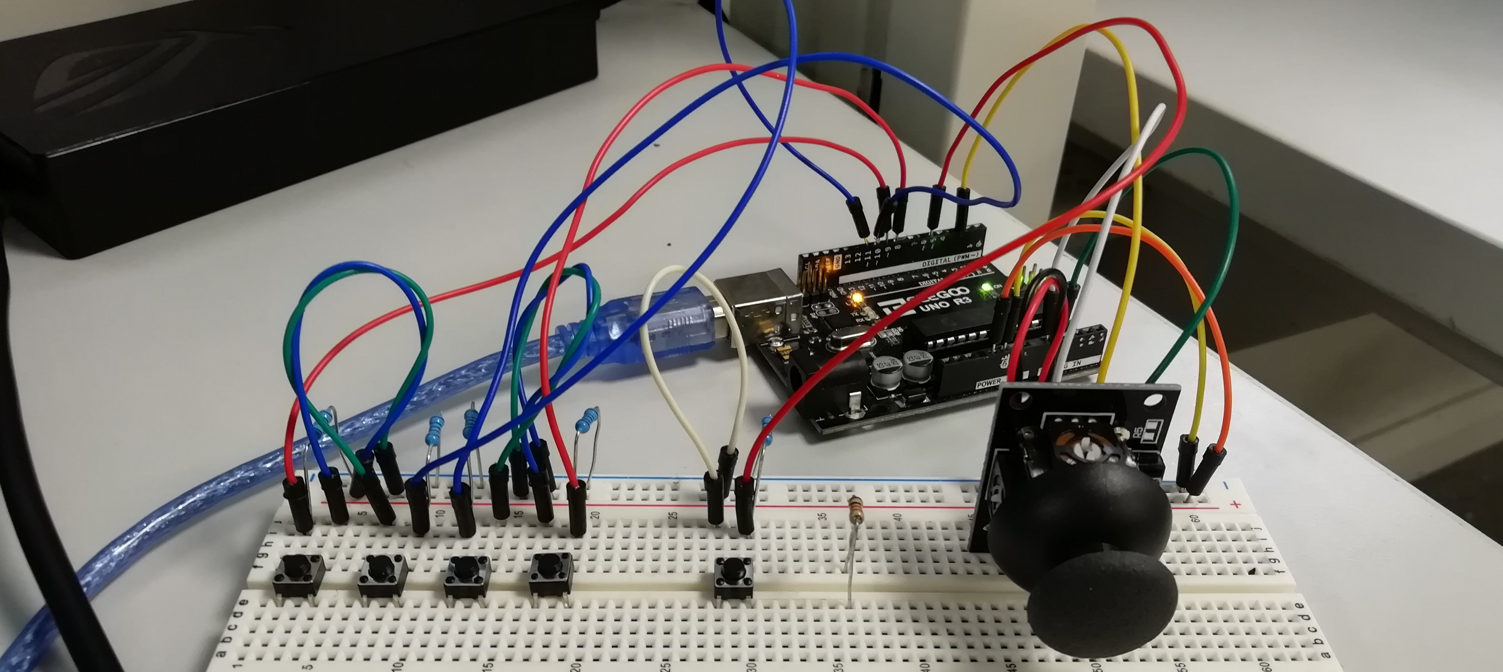
Project Deckard
Maghnus O Donnell – G00377514

Slide 2
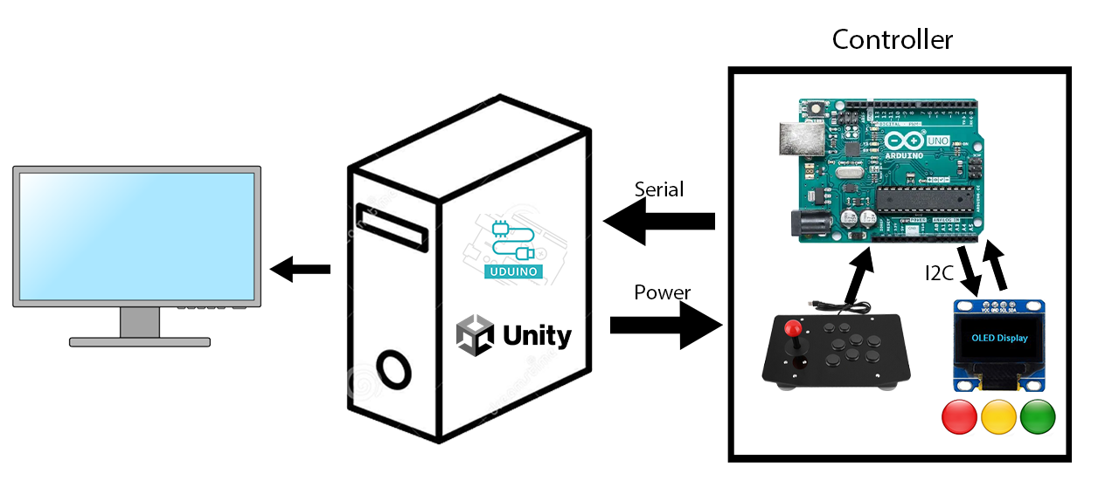
Project Deckard - Architecture Diagram

Slide 3

Project Deckard - Controller
Interfaces to Unity using the Uduino plugin.
Allows player to move the character on the x and z axis, and to rotate the camera
Player can fight enemies they might encounter.
Consists of:
Arduino Uno
PS2 joystick module
Set of buttons

Slide 4
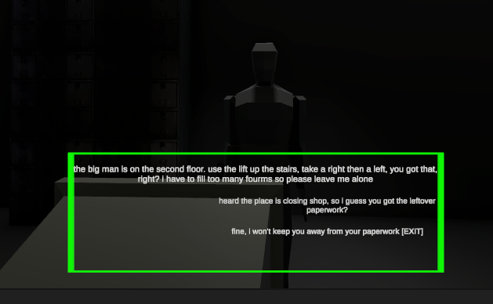
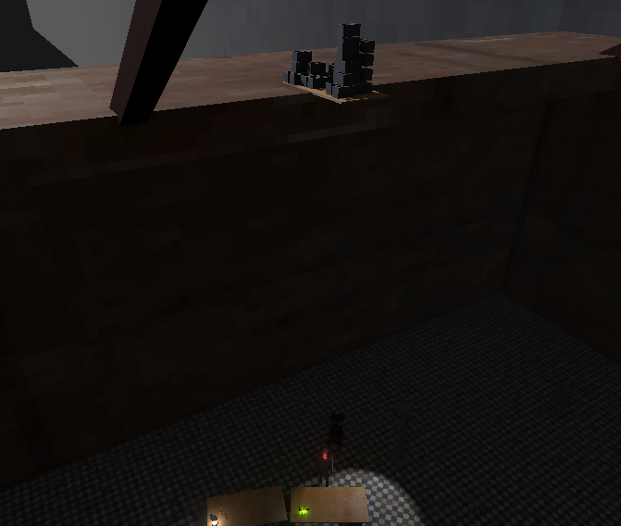
Project Deckard - Game
Inspired by games like Half-Life 2 and Prey (2017), as well as films like Blade Runner and Ghost in the Shell.
Play as a bounty hunter to track down a suspect, whose “identity” is randomly picked when starting a new game.
Given multiple ways to solve in-game roadblocks.
Can talk to other Non-Playable Characters to find out where the suspect is.
Parts of the game can change depending on the suspect’s identity

Slide 5
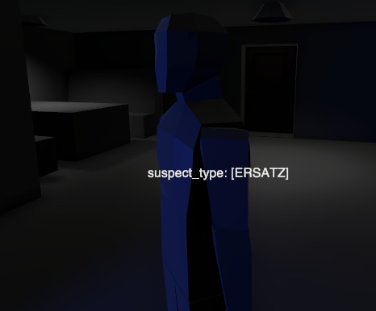
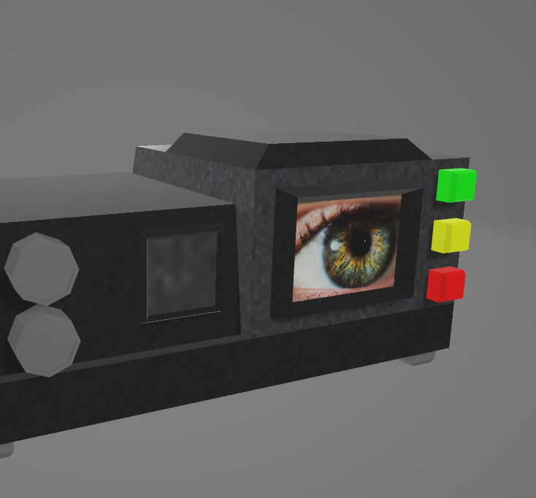
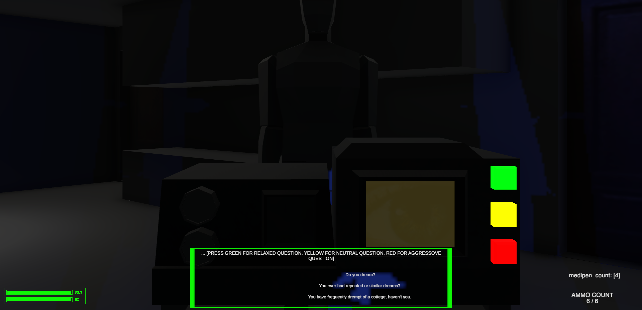
Project Deckard - Mini Game
Interacting with the suspect using the “F” key begins a conversation that can lead to the interrogation mini game starting.
Pressing buttons on machine progresses interrogation and increases suspect aggression.
If suspect aggression is between aggression limits defined in interrogation ScriptableObject, suspect’s “identity” is revealed.
Exceeding limit turns suspect aggressive, not reaching limit defines suspect as “unknown”.
Clues around level reveal suspect’s role.

Slide 6
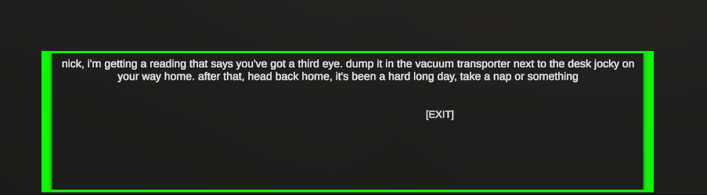
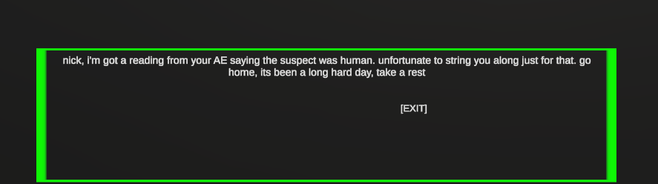
Project Deckard – Realtime asset Update
Top box text is displayed if suspect is a fake human
Bottom box text is displayed if suspect is a real human

Slide 7
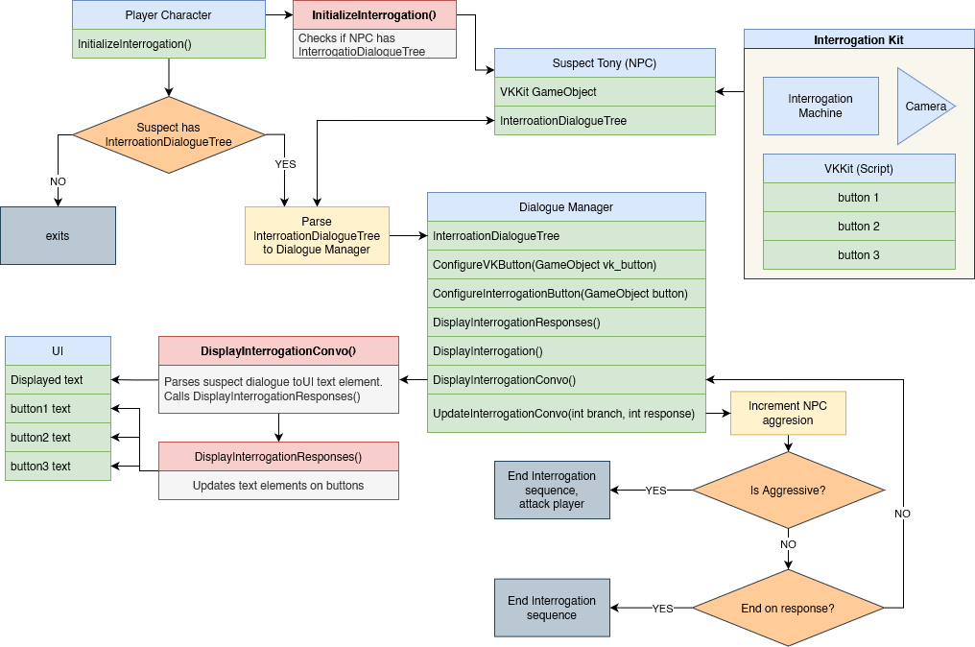
Project Deckard - Mini Game UML Diagram

